Slide 1

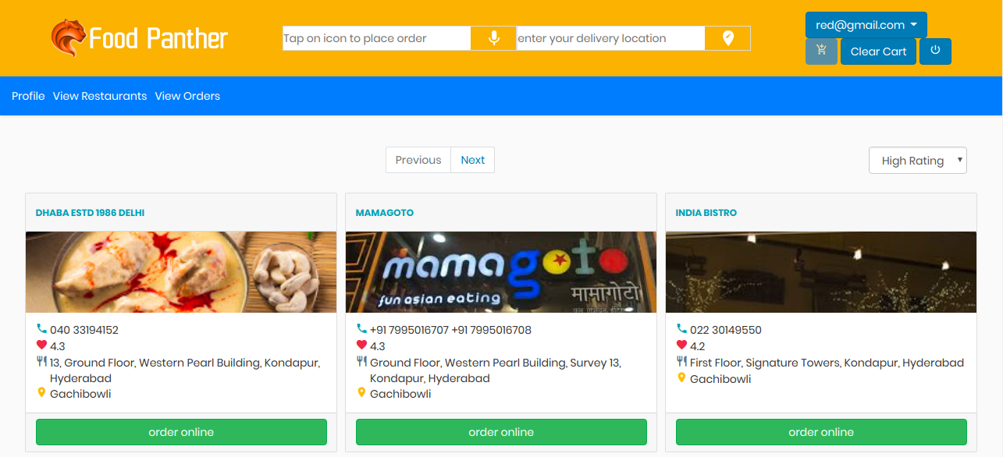
Project
FoodPanther

Slide 2

Abstract
Our web application provides an easy-to-use online platform for interaction between food lovers and restaurant owners, powered by voice search.

Slide 3
A Quick Intro
Food Panther aims providing an user-delighted experience in delivering food from restaurants to the user with just few clicks
In addition to real-time search suggestions, voice search functionality provides an easy way to stroll through the items in various restaurants
Machine Learning based recommendation systems reduces the bounce rate of customer

Slide 4

USPs
Voice Powered Search
ML based Restaurant Recommendations
Real-time search suggestions
Location Detection
Food item and restaurant filters
Responsive Web UI
User-friendly navigation

Slide 5
Approach
Data Gathering & Refining
Database Implementation
USPs Implementation
UI Improvements & Deployment
Developed web-scraping code to scrape data from zomato.com using beautifulsoup in Python
Using Flask-SQLAlchemy,
Created and worked with normalized database schema in SQLite & populated tables with real-data from web-scraping
> Voice search using the HTML5 Speech Recognition API
> ML based recommendation system using Nearest Neighbour Algorithm
> Location using Google Maps API
> Using Bootstrap, HTML,CSS and JS , designed responsive web pages and added item filters
> Deployed into PythonAnywhere PAAS using virtualenv

Slide 6

Environment
Python 3.6
Flask ,Flask-SQLAlchemy
SQLite DB
Bootstrap
HTML, CSS , JS
PythonAnywhere PAAS

Slide 7
Roles & Functionalities
Vendor | User
Register & Login | Register & Login
View/Edit profile | View/Edit profile
Add/View Restaurant | View Restaurants
Add/View Menu items | Do voice-based item search
 | Add items to cart
 | Check out and Place Order
 | View Previously Placed Orders

Slide 8
Database
Tables
User ( Stores the user details)
Vendor (Stores the vendor details)
Restaurant (Stores the Restaurant details)
Orders (Stores the order details)
VendorRestaurant (Maintains the vendor restaurant relationship)
Menu (Stores the item details)
Cuisines(Stores all available Cuisines)
Restaurant_Cuisines(Stores all types of restaurant cuisines relationship)

Slide 9
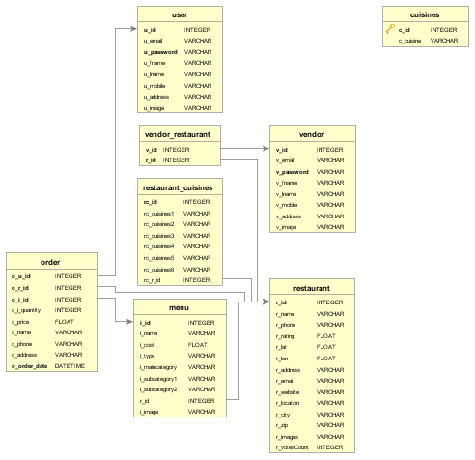
Database Schema

Slide 10
Future Scope
Implementing Payment Gateway
Vendor Analytics
Live Tracking

Slide 11
Thank You

